Slide 1
Manipulating Information (1)

Slide 2
Outline
Bit-level operations
Suggested reading
  2.1.7~2.1.10

Slide 3
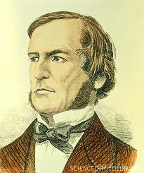

Boolean Algebra
Developed by George Boole(1815-1864)
  Algebraic representation of logic
    Encode “True” as 1
    Encode “False” as 0
Claude Shannon(1916–2001)founded the information theory
  made the connection between Boolean algebra and digital logic
Plays a central role in the design and analysis of digital systems

Slide 4
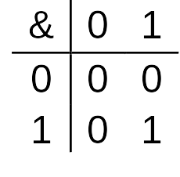
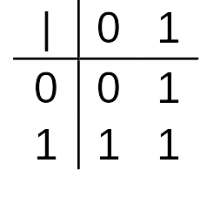
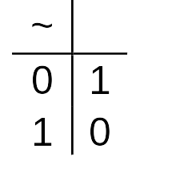
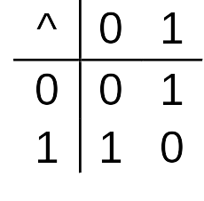
Boolean Algebra
And
  A&B = 1 when both A=1 and B=1
Or
  A|B = 1 when either A=1 or B=1
Not
  ~A = 1 when A=0
Exclusive-Or (Xor)
  A^B = 1 when either A=1 or B=1, but not both

Slide 5
General Boolean Algebras
Operate on Bit Vectors
  Operations applied bitwise
01101001
& 01010101
01000001
01101001
| 01010101
01111101
01101001
^ 01010101
00111100
~ 01010101
10101010

Slide 6
General Boolean Algebras
Representation of Sets
  Width w bit vector represents subsets of {0, …, w–1}
  a_{j} = 1 if j ∈ A
    01101001 { 0, 3, 5, 6 }
    01010101 { 0, 2, 4, 6 }
  & Intersection 01000001 { 0, 6 }
  | Union 01111101 { 0, 2, 3, 4, 5, 6 }
  ^ Symmetric difference 00111100 { 2, 3, 4, 5 }
  ~Complement 10101010 { 1, 3, 5, 7 }

Slide 7
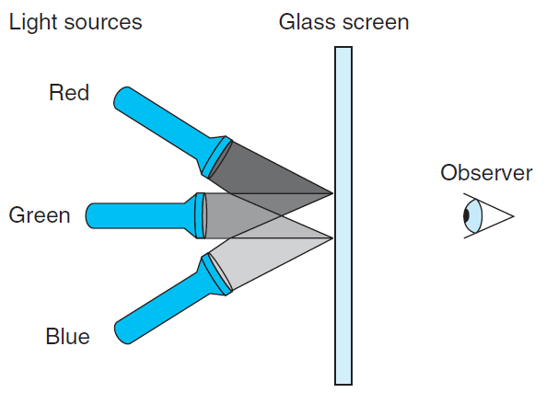
RGB Color Model

Slide 8
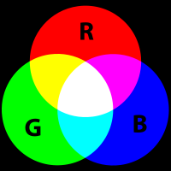
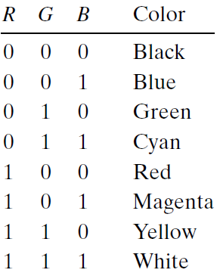
RGB Color Model
Magenta
Cyan

Slide 9
RGB Color Model
What would be the complement of each of the eight colors listed above?
  The complement of a color is formed by
    turning off the lights that are on and
    turning on the lights that are off
Describe the effect of applying Boolean operations on the following colors:
  Blue | Green =
  Yellow & Cyan =
  Red ^ Magenta =

Slide 10
Bit-Level Operations in C
Operations &, |, ~, ^ Available in C
  Apply to any “integral” data type
    long, int, short, char
  View arguments as bit vectors
  Arguments applied bit-wise

Slide 11
Bit-Level Operations in C
~0x41 | 0xBE
~0x00 | 0xFF
0x69 & 0x55 | 0X41
0x69 | 0x55 | 0x7D
~0100 0001
1011 1110
~0000 0000
1111 1111
0110 1001 & 0101 0101
0100 0001
0110 1001 | 0101 0101
0111 1101

Slide 12
Cool Stuff with Xor
Bitwise Xor is form of addition
With extra property that every value is its own additive inverse
  A ^ A = 0

Slide 13
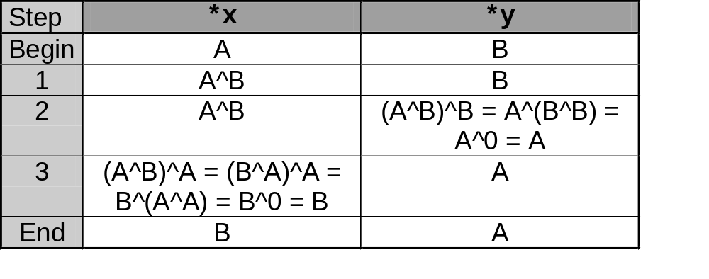
Cool Stuff with Xor
int inplace_swap(int *x, int *y)
{
*x = *x ^ *y; /* #1 */
*y = *x ^ *y; /* #2 */
*x = *x ^ *y; /* #3 */
}

Slide 14
Cool Stuff with Xor
1 void reverse_array(int a[], int cnt) {
2 int first, last;
3 for (first = 0, last = cnt-1;
4 first <= last;
5 first++,last--)
6 inplace_swap(&a[first], &a[last]);
7 }

Slide 15
Mask Operations
Bit pattern
  0xFF
    Having 1s for the least significant eight bits
    Indicates the lower-order byte of a word
Mask Operation
  X = 0x89ABCDEF
  X & 0xFF =?
Bit Pattern ~0
  Why not 0xFFFFFFFF?

Slide 16
Mask Operations
Write C expressions that work for any word size w ≥ 8
For x = 0x87654321, with w = 32
The least significant byte of x, with all other bits set to 0
  [0x00000021].

Slide 17
Mask Operations
All but the least significant byte of complemented, with the least significant byte left unchanged
  [0x789ABC21]
The least significant byte set to all 1s, and all other bytes of x left unchanged.
  [0x876543FF].

Slide 18
Bis & Bic
bis (int x, int m) (bit set)
  Set result z to 1 at each bit position where m is 1
bic(int x, int m) (bit clear)
  set result z to 0 at each bit position where m is 1
The Digital Equipment VAX
Use bis anf bic to implement
  Or(int x, int y)
  Xor(int x, int y)

Slide 19
Logical Operations in C
Logical Operators
  &&, ||, !
    View 0 as “False”
    Anything nonzero as “True”
    Always return 0 or 1
    Early termination (short cut)

Slide 20
Logical Operations in C
Examples (char data type)
  !0x41 --> 0x00
  !0x00 --> 0x01
  !!0x41 --> 0x01
  0x69 && 0x55 --> 0x01
  0x69 || 0x55 --> 0x01

Slide 21
Short Cut in Logical Operations
a && 5/a
  If a is zero, the evaluation of 5/a is stopped
  avoid division by zero
Using only bit-level and logical operations
  Implement x == y
  it returns 1 when x and y are equal, and 0 otherwise

Slide 22
Shift Operations in C
Left Shift: x << y
  Shift bit-vector x left y positions
    Throw away extra bits on left
    Fill with 0’s on right
Argument x
01100010
<< 3
00010000
Argument x
10100010
<< 3
00010000

Slide 23
Shift Operations in C
Right Shift: x >> y
  Shift bit-vector x right y positions
    Throw away extra bits on right
  Logical shift
    Fill with 0’s on left
  Arithmetic shift
    Replicate most significant bit on right
    Useful with two’s complement integer representation (especially for the negative number )
Argument x
01100010
Log. >> 2
00011000
Arith. >> 2
00011000
Argument x
10100010
Log. >> 2
00101000
Arith. >> 2
11101000

Slide 24
Shift Operations in C
What happens ?
  int lval = 0xFEDCBA98 << 32;
  int aval = 0xFEDCBA98 >> 36;
  unsigned uval = 0xFEDCBA98u >> 40;
It may be
  lval 0xFEDCBA98 (0)
  aval 0xFFEDCBA9 (4)
  uval 0x00FEDCBA (8)
Be careful about
  1<<2 + 3<<4 means 1<<(2 + 3)<<4

Slide 25
bitCount
Returns number of 1's a in word
Examples: bitCount(5) = 2, bitCount(7) = 3
Legal ops: ! ~ & ^ | + << >>
Max ops: 40

Slide 26
Sum 8 groups of 4 bits each
int bitCount(int x) {
int m1 = 0x11 | (0x11 << 8);
int mask = m1 | (m1 << 16);
int s = x & mask;
s += x>>1 & mask;
s += x>>2 & mask;
s += x>>3 & mask;

Slide 27
Combine the sums
/* Now combine high and low order sums */
s = s + (s >> 16);
/* Low order 16 bits now consists of 4 sums.
Split into two groups and sum */
mask = 0xF | (0xF << 8);
s = (s & mask) + ((s >> 4) & mask);
return (s + (s>>8)) & 0x3F;
}

